Slide 1

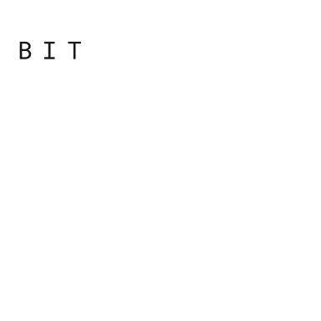
Programming
Principles
with JavaScript

Slide 2

Day overview
Recap and Coding Conventions
Switch
Introduction to Arrays
Loops

Slide 3
Switch

Slide 4
Switch
If you find yourself using an if condition and having too many else if parts, you could consider changing the if to a switch

Slide 5
Switch
var a = '1';
var result = '';
switch (a) {
case 1:
result = 'Number 1';
break;
case '1':
result = 'String 1';
break;
default:
result = 'I don\'t know';
break;
}
Parts of a switch are:
The switch statement
An expression in parentheses containing a variable
A number of case blocks enclosed in { }
Each case statement is followed by an expression
Optional break statement to signal the end of the case block. If this break statement is reached, the switch is all done
Optional default case is executed if none of the previous cases evaluated to true
Notes:
The result after executing this is "String 1". Let's see what the parts of a switch are:
• the switch statement,
• an expression in parentheses. The expression most often contains a variable, but can be anything that returns a value;
• a number of case blocks enclosed in curly brackets,
• each case statement is followed by an expression. The result of the expression is compared to the expression found after the switch statement. If the result of the comparison is true, the code that follows the colon after the case is executed;
• there is an optional break statement to signal the end of the case block. If this break statement is reached, the switch is all done. Otherwise, if the break is missing, the program execution enters the next case block;
• there's an optional default case marked with the default statement and followed by a block of code. The default case is executed if none of the previous cases evaluated to true.

Slide 6
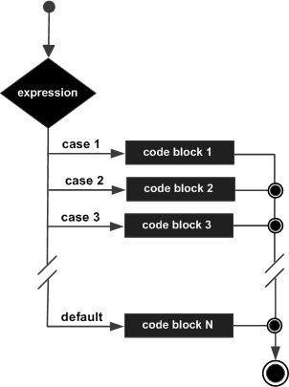
Switch
Step-by-step procedure for executing a switch statement

Slide 7
step-by-step procedure
var a = '1';
var result = '';
switch (a) {
case 1:
result = 'Number 1';
break;
case '1':
result = 'String 1';
break;
default:
result = 'I don\'t know';
break;
}
Evaluate the switch expression found in parentheses;
Remember it;
1.

Slide 8
step-by-step procedure
var a = '1';
var result = '';
switch (a) {
case 1:
result = 'Number 1';
break;
case '1':
result = 'String 1';
break;
default:
result = 'I don\'t know';
break;
}
Move to the first case and compare its value with the one from step 1
2.

Slide 9
step-by-step procedure
var a = '1';
var result = '';
switch (a) {
case 1:
result = 'Number 1';
break;
case '1':
result = 'String 1';
break;
default:
result = 'I don\'t know';
break;
}
If the comparison in step 2 returns true, execute the code in the case block
3.

Slide 10
step-by-step procedure
var a = '1';
var result = '';
switch (a) {
case 1:
result = 'Number 1';
break;
case '1':
result = 'String 1';
break;
default:
result = 'I don\'t know';
break;
}
After the case block is executed, if there's a break statement at the end of it, exit the switch
4.

Slide 11
step-by-step procedure
var a = '1';
var result = '';
switch (a) {
case 1:
result = 'Number 1';
break;
case '1':
result = 'String 1';
break;
default:
result = 'I don\'t know';
break;
}
If there's no break or step 2 returned false, move on to the next case block
5.

Slide 12
step-by-step procedure
var a = '1';
var result = '';
switch (a) {
case 1:
result = 'Number 1';
break;
case '1':
result = 'String 1';
break;
default:
result = 'I don\'t know';
break;
}
Repeat steps 2 to 5.
6.

Slide 13
step-by-step procedure
var a = '1';
var result = '';
switch (a) {
case 1:
result = 'Number 1';
break;
case '1':
result = 'String 1';
break;
default:
result = 'I don\'t know';
break;
}
If no exit in step 4, execute the code following the default statement
7.

Slide 14
Fall-through
var car = 'bmw';
var result = '';
switch (car) {
case 'vw':
case 'audi':
case 'bmw':
result = 'Great german car!';
break;
case 'fiat':
result = 'Good Italian car!';
break;
default:
result = 'I don\'t know';
break;
}
Fall-through in switch statement

Slide 15
Best Practice Tips
Indent the code that follows the case lines.
Don't forget to break
Use the default case
Notes:
Best practice tips
• Indent the code that follows the case lines. You can also indent case from the switch, but that doesn't give you much in terms of readability.
• Don't forget to break.
• Sometimes, you may want to omit the break intentionally,but that's rare. It's called a fall-through and should always be documented because it may look like an accidental omission. On the other hand, sometimes you may want to omit the whole code block following a case and have two cases sharing the same code. This is fine, but doesn't change the rule that if there's code that follows a case statement, this code should end with a break. In terms of indentation, aligning the break with the case or with the code inside the case is a personal preference; again, being consistent is what matters.
• Use the default case. This helps you make sure you always have a meaningful result after the switch statement, even if none of the cases matches the value being switched.

Slide 16

Practical
Notes:
Starting with the bootcamp
Hoping to catch the wave and achieve much more

